Slide 1
DTV Receiver – Hardware Architecture

Slide 2
Topics
What is DTV?
Benefits of DTV
What is DTV Receiver?
Types of DTV Receiver
Hardware architecture of DTV Receiver
Tuner
Demodulator
CA
De-Multiplexer
MPEG Decoder
NVRAM and Flash
CPU

Slide 3
What is DTV
Digital Television (DTV) is a system for transmitting, receiving and viewing higher quality television images and stereo audio.
DTV is completely digital and involves
Digital cameras
Digital transmission
Digital display
The video and audio information is digitized and compressed using the MPEG compression standard (source coding)
DTV Standards
Digital Video Broadcasting (DVB)
Advanced Television Systems Committee (ATSC)
Integrated Services Digital Broadcasting (ISDB)

Slide 4
Benefits of DTV
Increased channel capacity such that more channels can be offered within a fixed amount of broadcast bandwidth.
Increased programming options including interactivity and Video on Demand (VoD).
Improved picture quality even with a standard-definition signal.
Improved security to prevent unauthorized persons from receiving services
Ease of storing data for future use and reprocessing
Ability to supply more services like
MHP (Multimedia Home Platform)
EPG (Electronic Program Guide)

Slide 5
What is DTV receiver?
DTV stands for Digital TeleVision - Transmitting TV using digital signals
DTV receiver is a set top box that permits the reception of Digital Television. It is usually connected to the TV set or incorporated in the TV set
Functions
Receives digital TV broadcasts from a cable, satellite or terrestrial network
Decodes the incoming signal
Displays good quality pictures
Outputs digital surround sound
Renders internet services
Provides interactive games

Slide 6
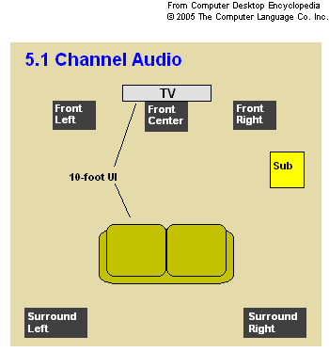
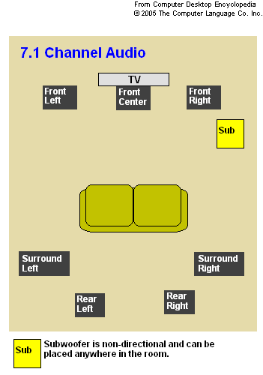
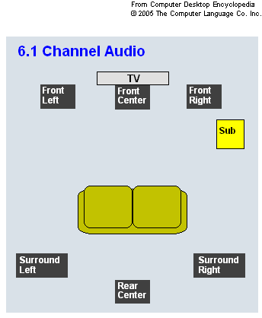
Surround Sound
An audio recording and playback system that uses five or more audio channels plus a subwoofer channel

Slide 7
Types of Digital TV Receiver
Set-top box (STB)
Separate box to be connected for receiving Digital data and is connected to a analog TV
Integrated Digital TV (IDTV)
Receiver is built into a TV set
Can receive digital or analog broadcasts with no extra hardware
PC with digital tuner card
Similar to analog TV tuners, except it decodes digital TV signals

Slide 8
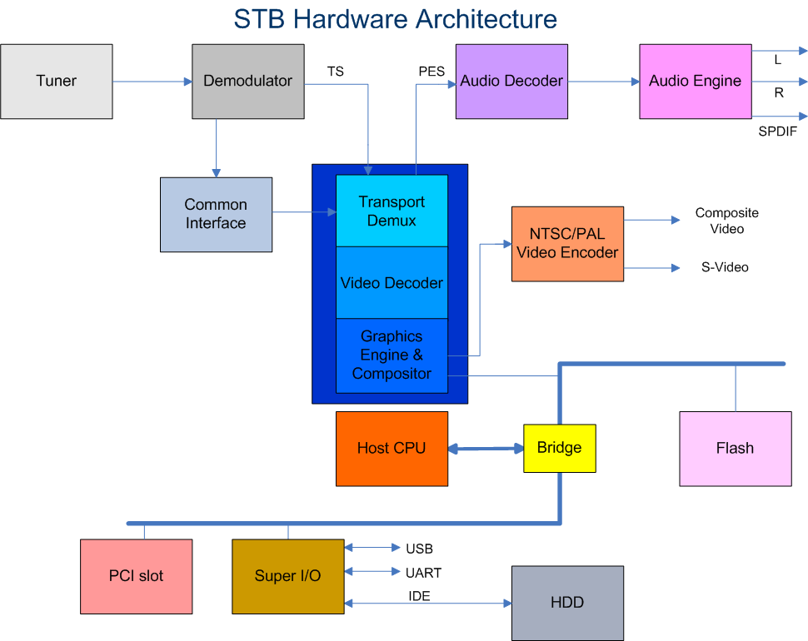
Set Top Box

Slide 9
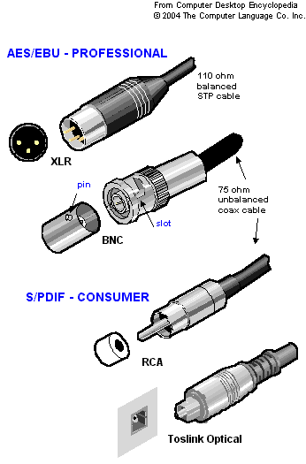
SP/DIF
SP/DIF stands for Sony/Philips Digital InterFace
It is a serial interface for transferring digital audio from CD and DVD players to amplifiers and TVs.
It is typically used to transmit PCM and Dolby Digital 5.1, but is not tied to any sampling rate or audio standard.
S/PDIF uses unbalanced 75 ohm coaxial cable up to 10 meters with RCA connectors or optical fiber terminated with a Toslink (Toshiba link) connector.
AES/EBU is the professional version of S/PDIF and uses a higher signal voltage.
They both support the same audio data with slight differences in the frame bits.
Conversion between these interfaces must be handled with electronic circuits, not by adapting one connector to another.

Slide 10
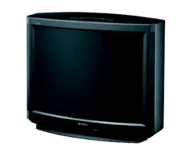
Hardware Architecture of DTV
Front End
Back End
Audio;
Video
MPEG Chip
CA
Module
De-
mux
Audio/Video
PES
MPEG
Decoder
Digital TS
On (Analog)
Carrier Wave
Tuner
De-
mod
Digital TS
Subtitles
Memory
Data
Packets
(Sections)
CPU
Graphics & OSD Generator
Return
Path
CPU
Memory
PSI/SI;CA; iTV Data
Tel./Cable/ADSL Modem
HardDisk
Ports:
RS-232; USB
10

Slide 11
Tuner
Tuner is a device which receives RF analog signal and outputs the MPEG Transport Stream
Tuners can be divided into three broad categories:
Broadcast In-band (IB) Tuner: Once the signal arrives from the physical transmission media, the IB tuner will isolate a physical from a multiplex of channels and convert to baseband. The term ‘’baseband’’ is used to describe a single channel or digital signal, extracted from broadband signal which is basically a stream of multiple channels.
Out Of Band (OOB) Tuner: This type of tuner facilitates the transfer of data between the head-end systems and the set-top box. They are widely used in cable set-top boxes for providing subscribers with medley of interactive services. Implementations of the OOB tuner tend to operate within 100 to 350 MHz frequency band.
Return Path Tuner: This tuner allows a subscriber to activate the return of path and send data back to the interactive services provider. Implementations of this tuner tend to operate within the 5 to 60 MHz frequency band.

Slide 12
Demodulator
Demodulator converts the Analog signal to Digital signal
Then, it checks for errors and forward the bit stream to the demultiplexer
Modulation schemes in DTV network
Transmission mechanism | Modulation
Satellite | QPSK
Cable | QAM
Terrestrial | OFDM

Slide 13
Conditional Access
Conditional Access (CA) is the protection of content by requiring certain criteria to be met before granting access to this content
Access to the content is provided only to those with valid decryption smart cards
Algorithm is proprietary to the user
e.g. DVB Common Scrambling Algorithm
Scrambling and Encryption are used
Scrambling Vs Encryption
Scrambling is a technique used to distort or garble (a signal) so as to render it unintelligible without a special receiver
Scrambling is a form of analogue signal manipulation that is applied pseudo-randomly to analogue signals, generally under the control of an encrypted digital code that is transmitted in the vertical interval of the television signal.
Encryption is a process of combining the entire digital bit stream representing the digital television signal with a digital encryption code.

Slide 14
De-Multiplexer
Demultiplexer takes an MPEG-2 transport stream and locates the required elements
Audio and video streams
Broadcast data streams
Service information
Some service information for the network are also added
Demultiplexer passes these streams on to other parts of the system
Service information and data streams to the CPU (if it is interested)
Audio and video to the MPEG decoder
Other data from the transport stream is thrown away
Demultiplexer may include section filtering capability to filter other MPEG-2 sections as requested by applications

Slide 15
MPEG Decoder
MPEG Decoder decodes audio and video MPEG streams and displays them on the screen
It may include support for graphical overlays
Cursor, graphics
Some receivers support up to five graphics planes
Background, video, two graphics planes, cursor
It may include support for scaling, clipping and repositioning video, but this may be limited
It is typically combined with the graphics processor
Makes it easier to integrate different elements of the display

Slide 16
NVRAM and Flash
NVRAM (Non Volatile RAM) stores the configuration information, which may include:
Country Code
Language Preferences - OSD, Audio, Subtitle
Audio Mode – Mono, Stereo, Left, Right
Volume Level
OSD Transparency
Last Viewed Channel – Channel No, Service ID, Service Type
Channel Lock Password
Display Parameters – Brightness, Contrast, Saturation, Tint
Software Version
Flash stores the following details:
Applications and system software
Frequency Database
Service Database
Country Database
Icons used in the platforms

Slide 17
CPU
CPU handles all of the other tasks in the system
Decoding and handling service information
Decoding broadcast data streams
User interaction
Running built-in or downloaded applications
It is integrated with the MPEG-2 decoder and other components in most of the cases

Slide 18
Thank you

Slide 19


